Slide 1

David M. Kroenke and David J. Auer Database Processing: Fundamentals, Design, and Implementation
Chapter Ten C:
Managing Databases with
MySQL 5.6

Slide 2
Chapter Objectives
To install MySQL and create a database
To use the MySQL Workbench graphical utilities
To submit both SQL DDL and DML via the MySQL Workbench
To understand the use of SQL/Persistent Stored Modules (SQL\PSM) in MySQL’s variant of SQL
To understand the purpose and role of user-defined functions and know how to create simple user-defined functions

Slide 3
Chapter Objectives
To understand the purpose and role of stored procedures and know how to create simple stored procedures
To understand the purpose and role of triggers and know how to create simple triggers
To understand how MySQL implements concurrency control
To understand how MySQL implements server and database security
To understand the fundamental features of MySQL backup and recovery facilities

Slide 4
Introduction
There are several versions of MySQL 5.6, and these can be reviewed at www.mysql.com/products/
Of particular interest to us are two versions
MySQL Enterprise—MySQL Enterprise (www.mysql.com/products/enterprise/ ) is a subscription service that includes the MySQL Enterprise Server, MySQL Production Support, and some utilities that are not available as open-source downloads (including the MySQL Enterprise Monitor and MySQL Query Analyzer). A 30-day trial version is available.
MySQL Community Edition—MySQL Community Edition (formerly MySQL Community Server) (http://dev.mysql.com/downloads/mysql/5.6.html) is the free version of MySQL available for download.

Slide 5
View Ridge Gallery
View Ridge Gallery is a small art gallery that has been in business for 30 years.
It sells contemporary European and North American fine art.
View Ridge Gallery has one owner, three salespeople, and two workers.
View Ridge Gallery owns all of the art that it sells—it holds no items on a consignment basis.

Slide 6
Application Requirements
View Ridge Gallery application requirements:
Track customers and their artist interests
Record gallery’s purchases
Record customers’ art purchases
List the artists and works that have appeared in the gallery
Report how fast an artist’s works have sold and at what margin
Show current inventory in a Webpage

Slide 7
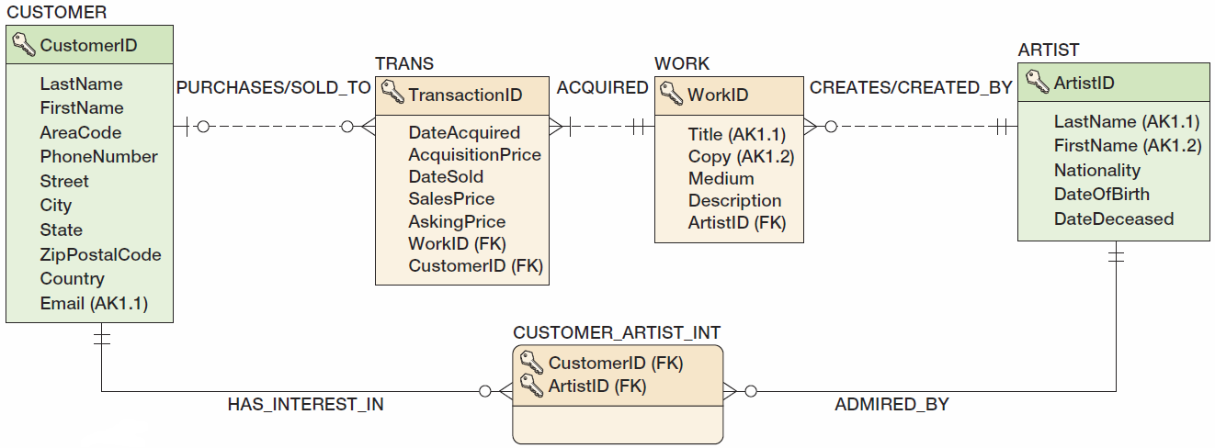
View Ridge Gallery Database Design

Slide 8
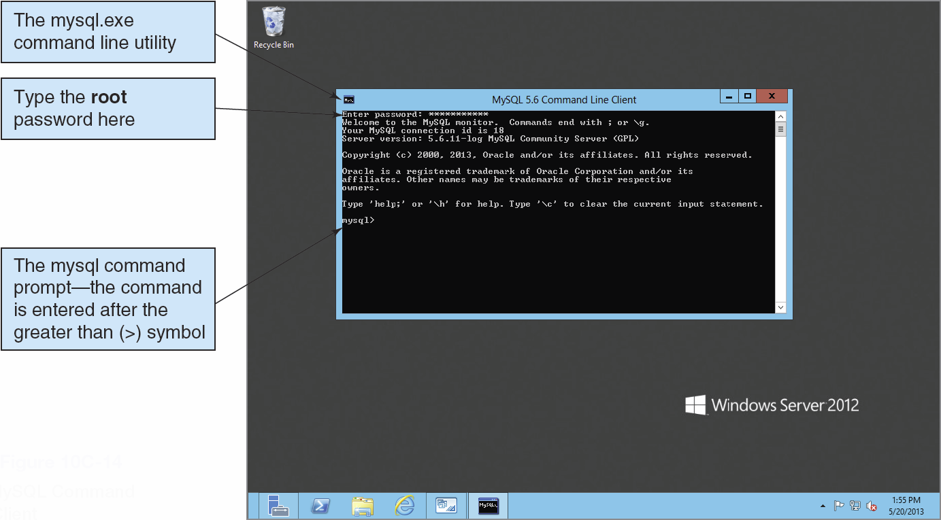
MySQL 5.6 Utilities: MySQL Command Line Client

Slide 9
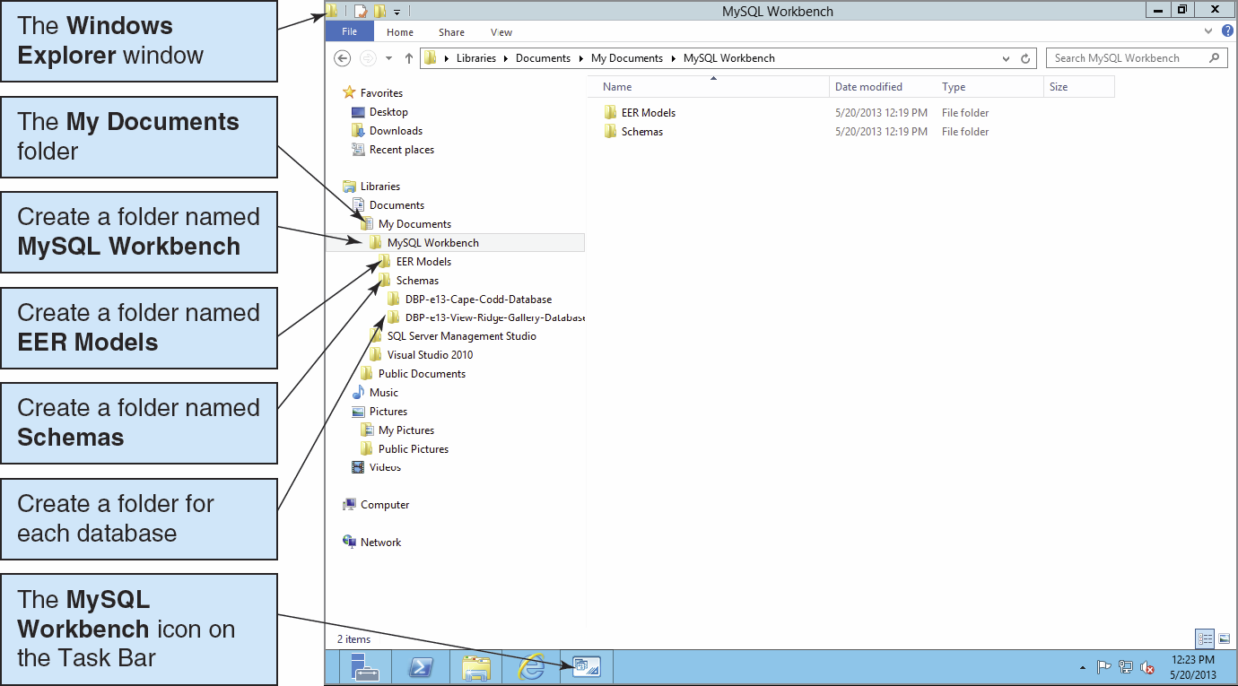
MySQL 5.6 Utilities: Setting up the MySQL Workbench Folders

Slide 10
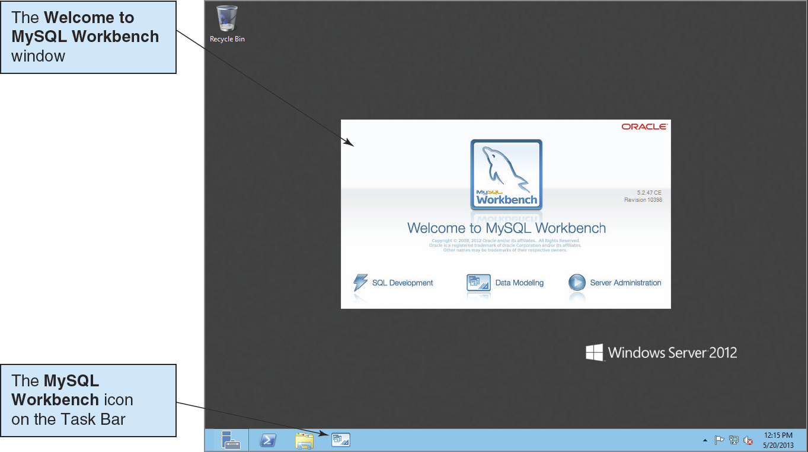
MySQL 5.6 Utilities: The MySQL Workbench I

Slide 11
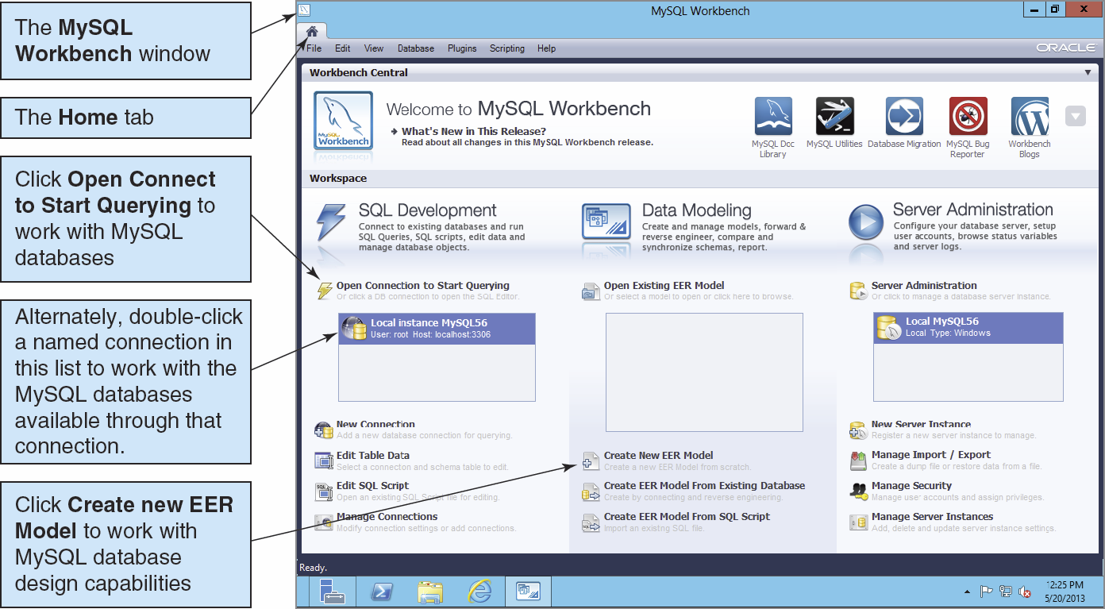
MySQL 5.6 Utilities: The MySQL Workbench II

Slide 12
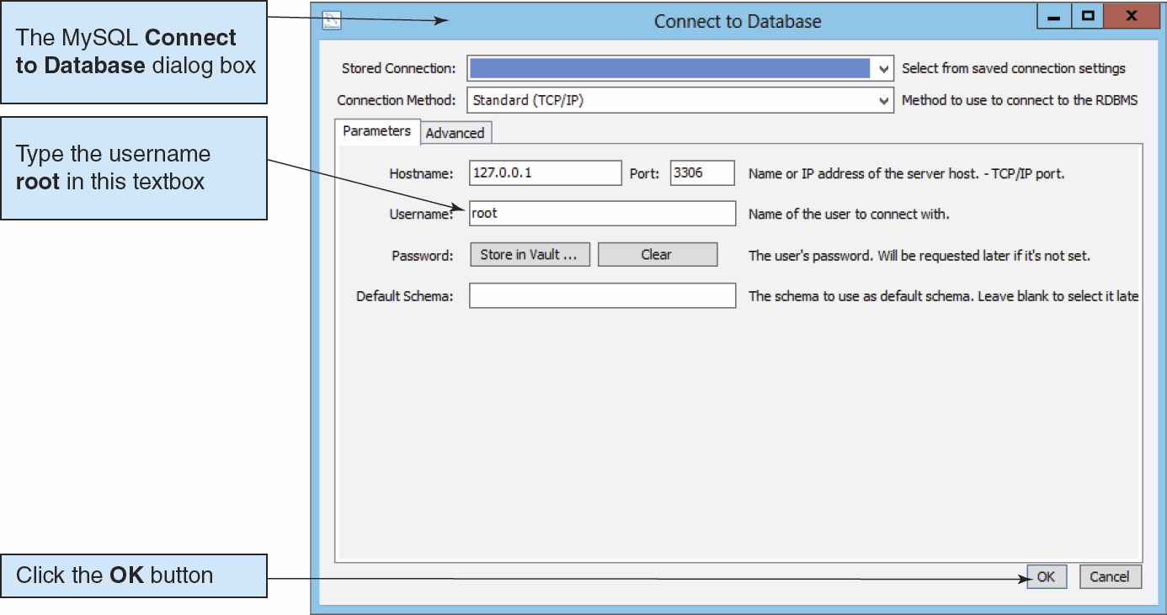
The MySQL Workbench: Connect to Database Dialog Box

Slide 13
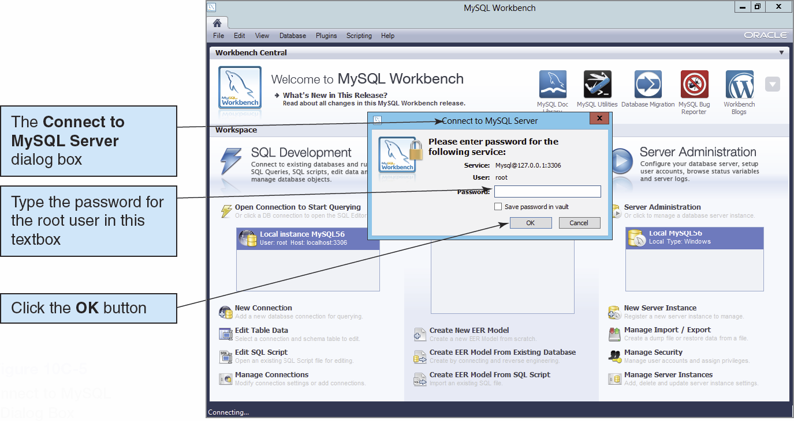
The MySQL Workbench: Connect to MySQL Server Dialog Box

Slide 14
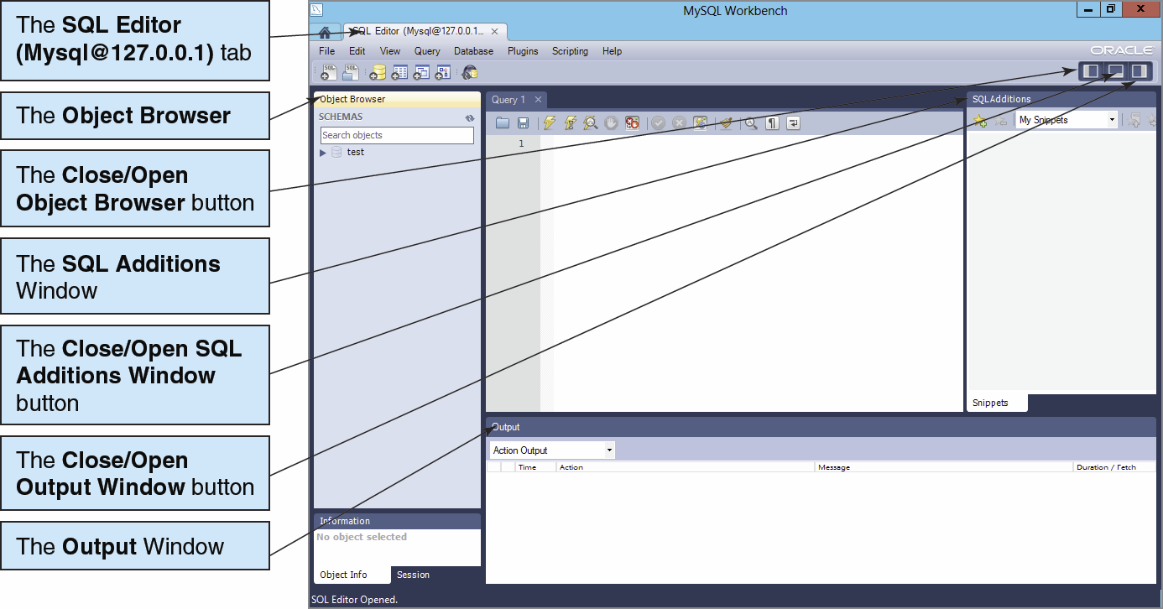
The MySQL Workbench: The SQL Editor Window I

Slide 15
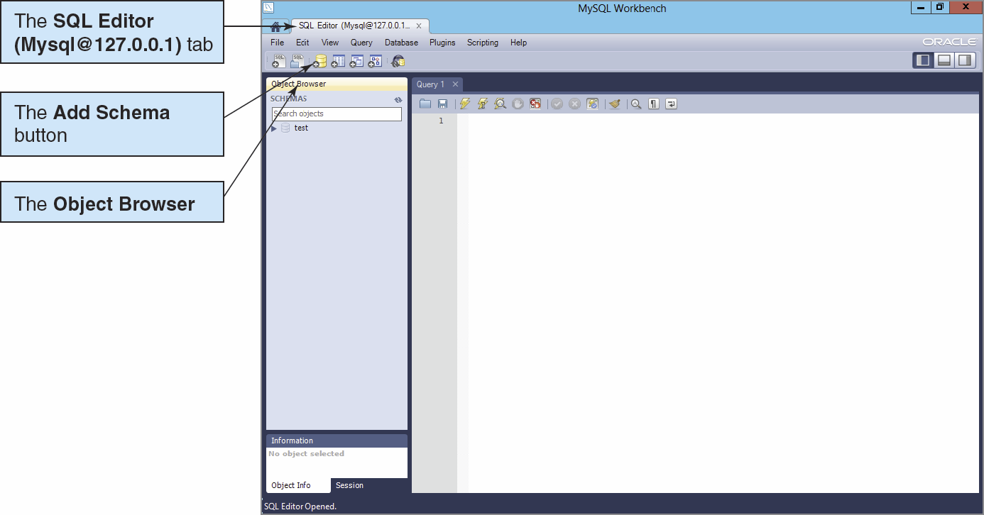
Creating a New Database I The Add Schema Button

Slide 16
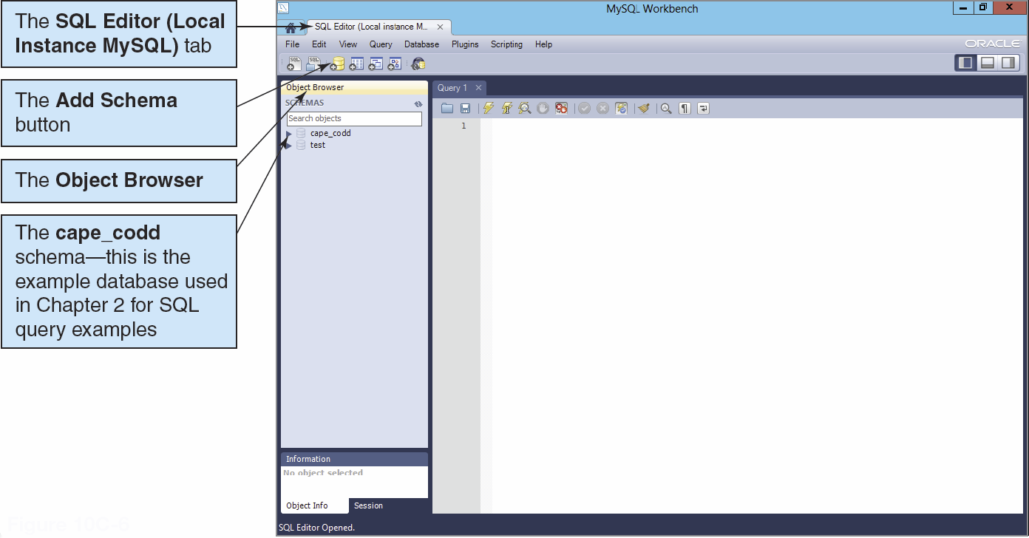
Creating a New Database II Local Instance MySQL Connection

Slide 17
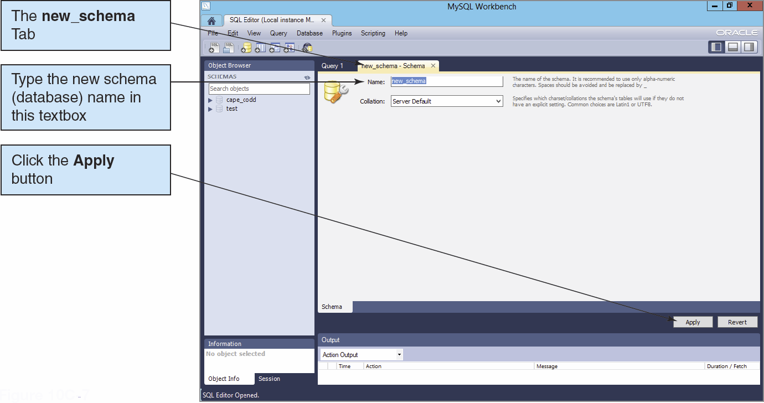
Creating a New Database II

Slide 18
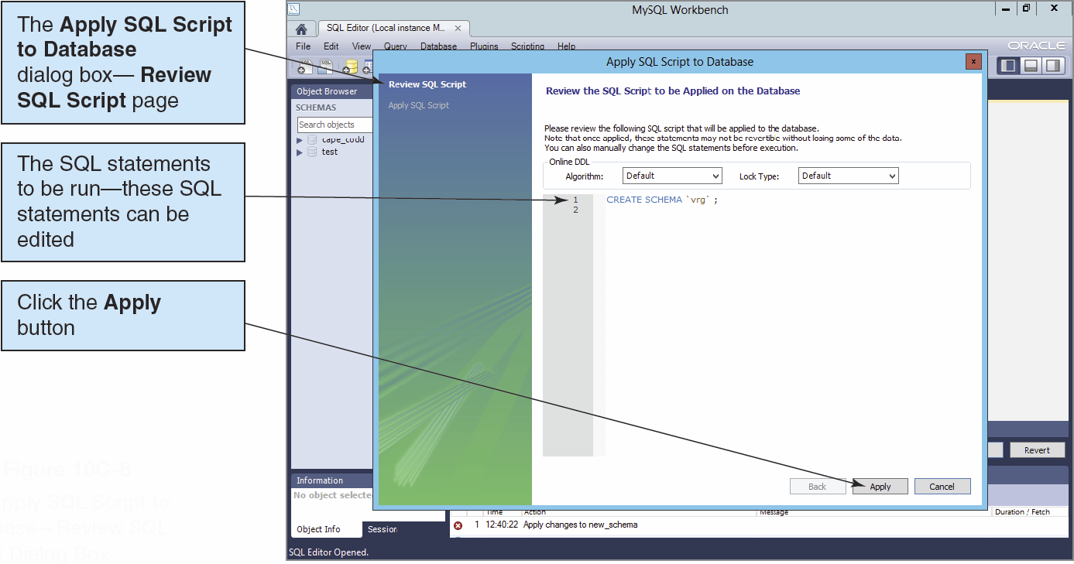
Creating a New Database III

Slide 19
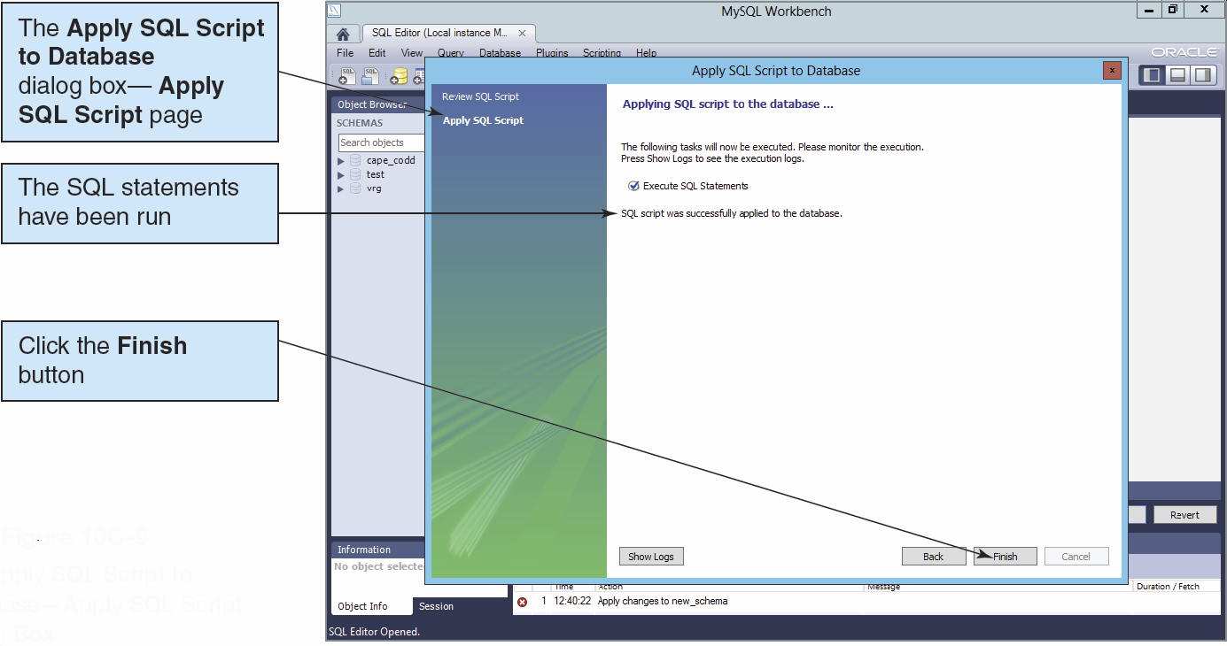
Creating a New Database IV

Slide 20
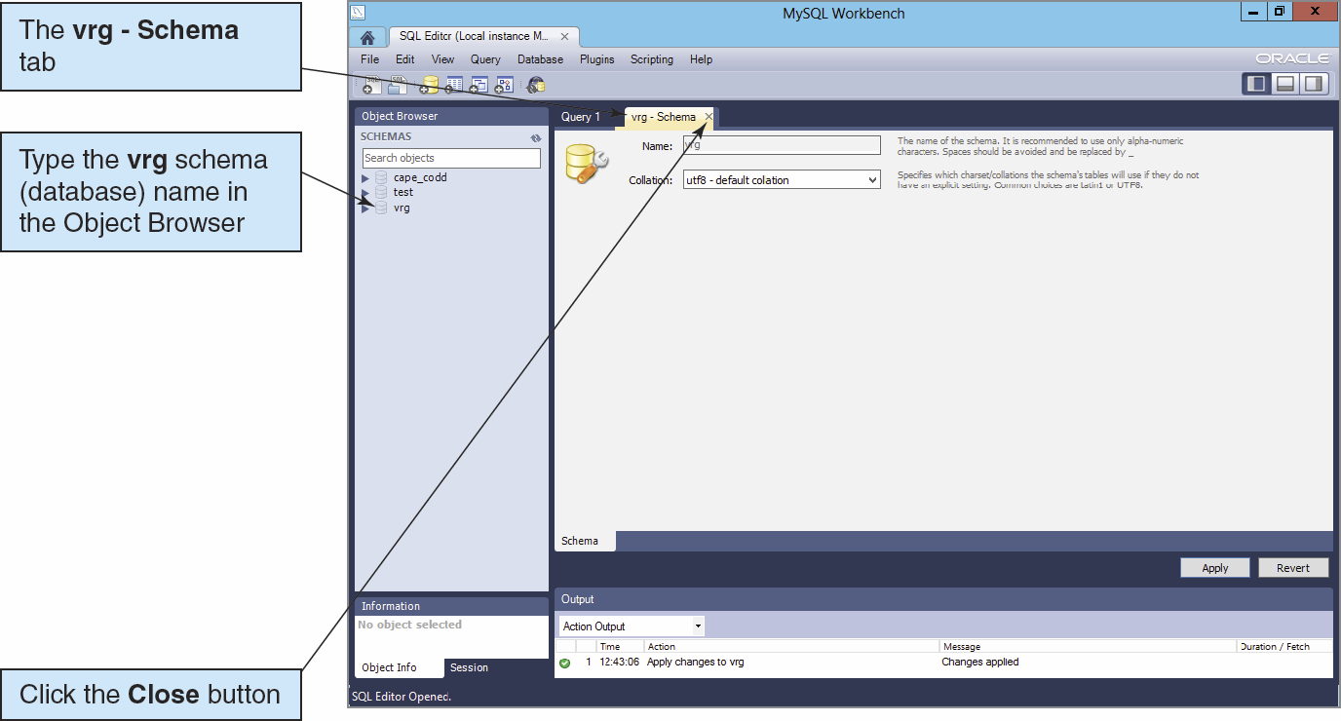
Creating a New Database V

Slide 21
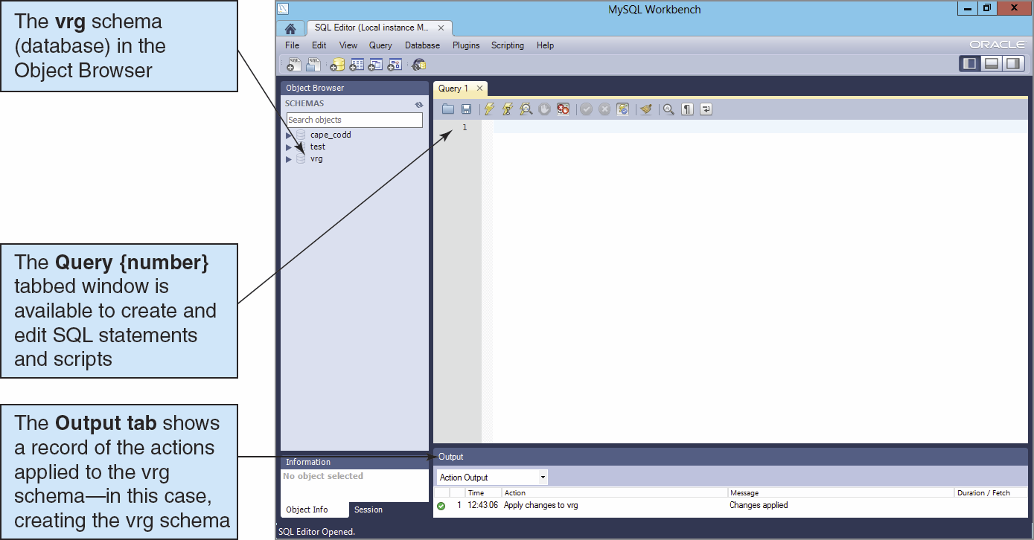
Creating a New Database VI

Slide 22
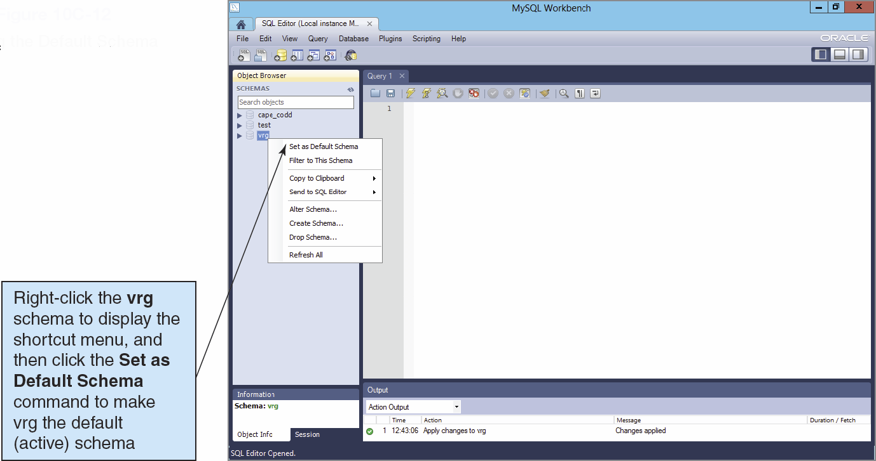
Setting the Default Schema

Slide 23
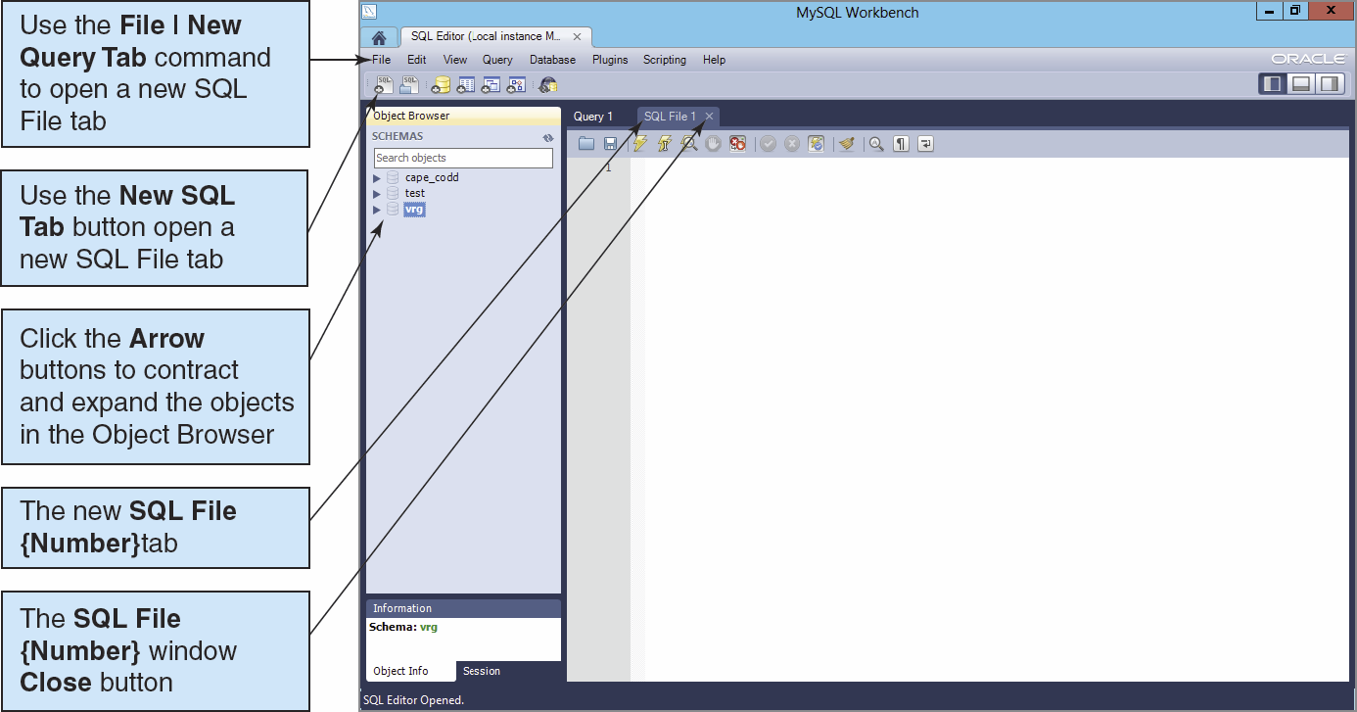
SQL Scripts I

Slide 24
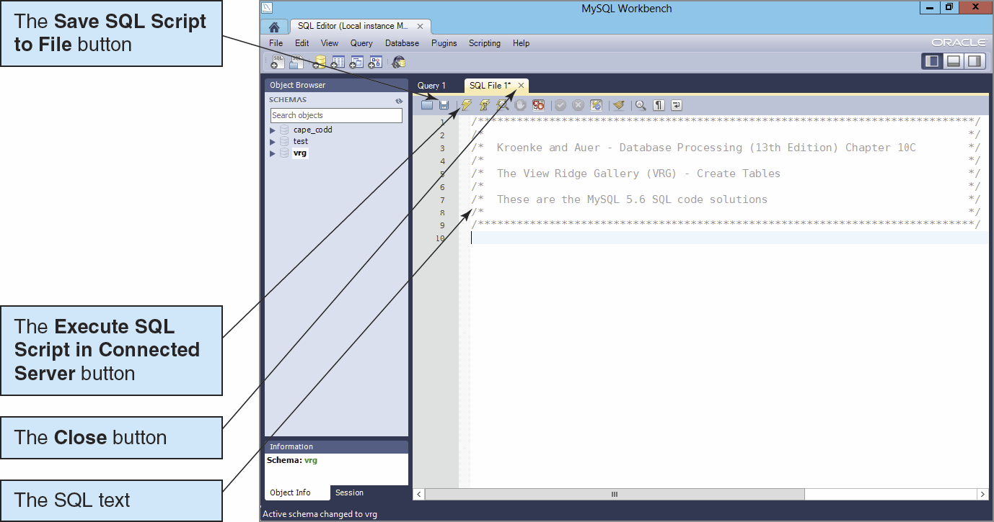
SQL Scripts II

Slide 25
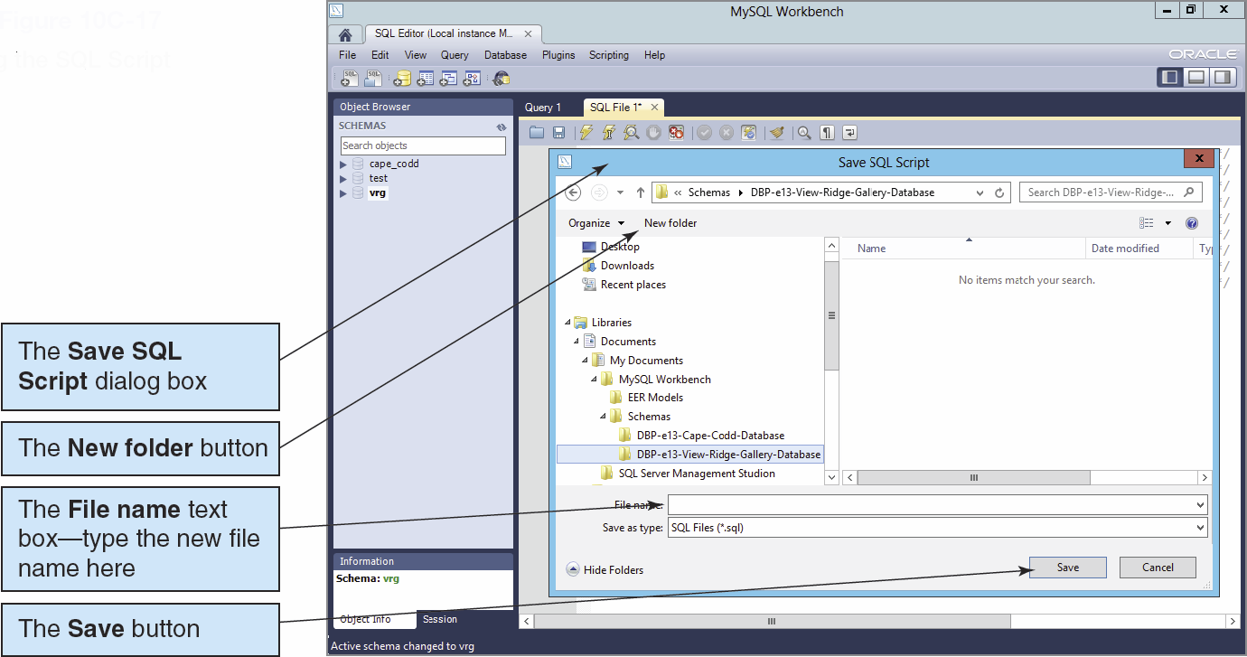
SQL Scripts III

Slide 26
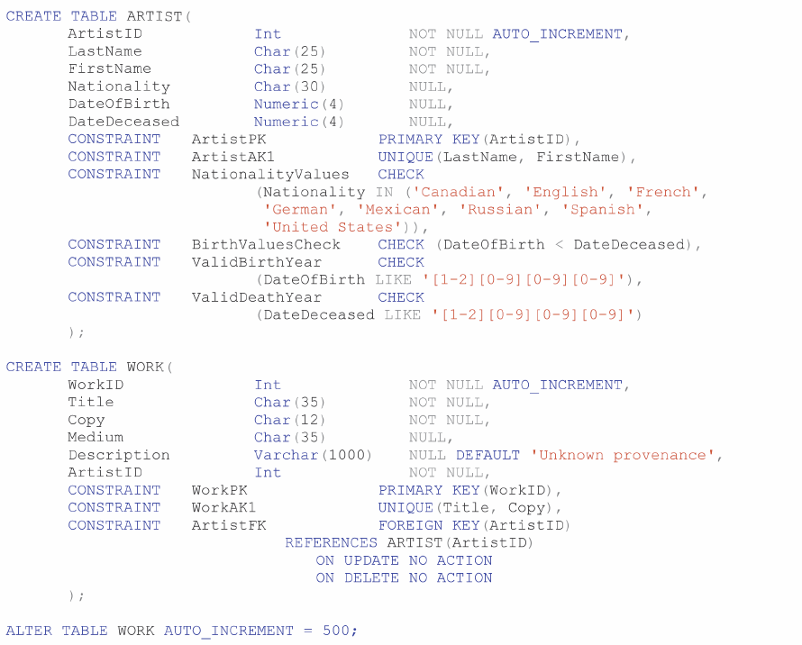
MySQL CREATE TABLE Statements for the View Ridge Schema I

Slide 27
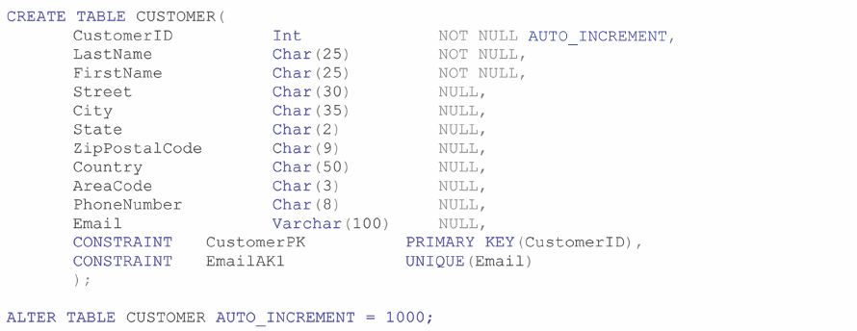
MySQL CREATE TABLE Statements for the View Ridge Schema II

Slide 28
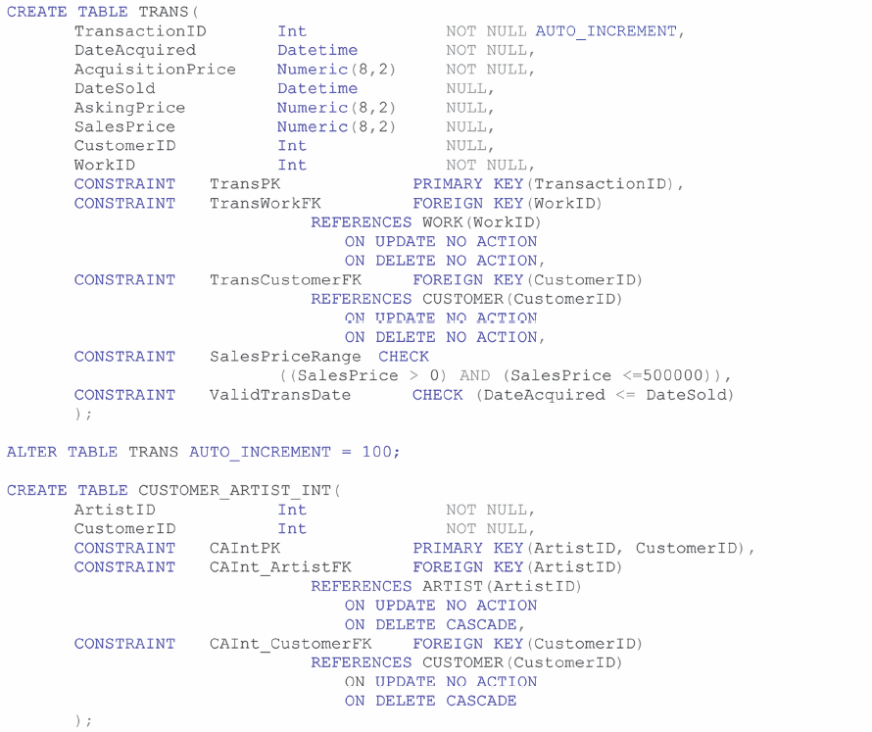
MySQL CREATE TABLE Statements for the View Ridge Schema III

Slide 29
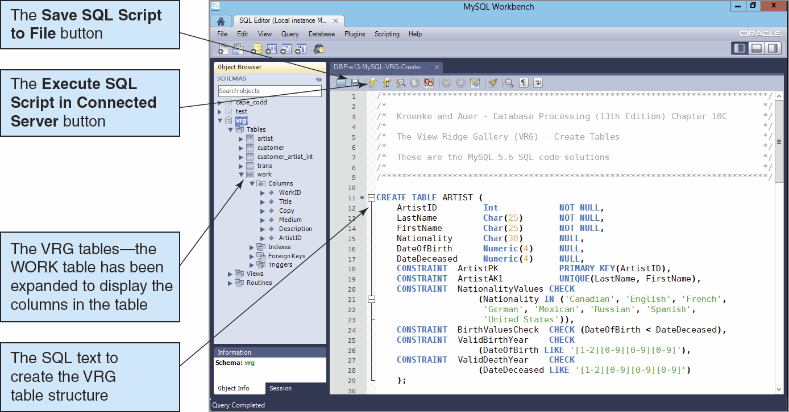
MySQL CREATE TABLE Statements: Running the Script

Slide 30
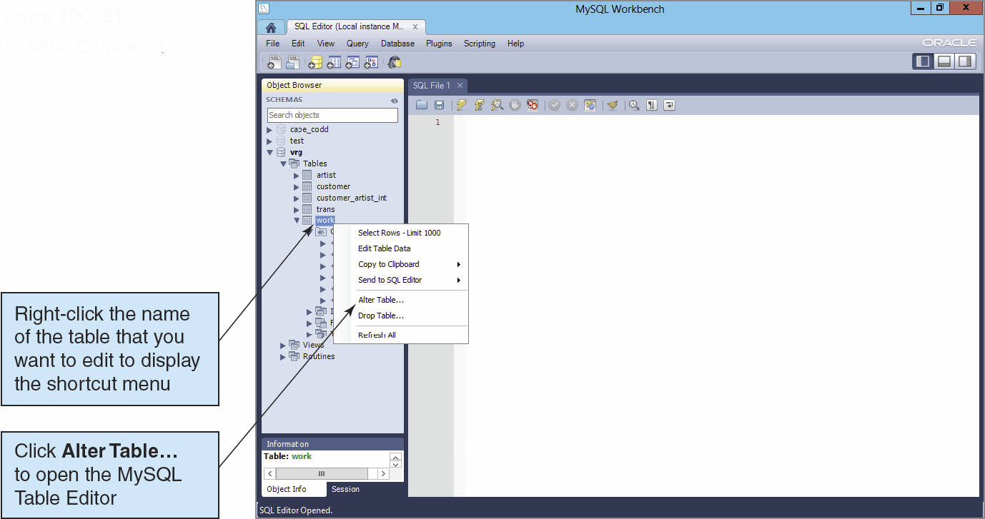
Viewing Tables

Slide 31
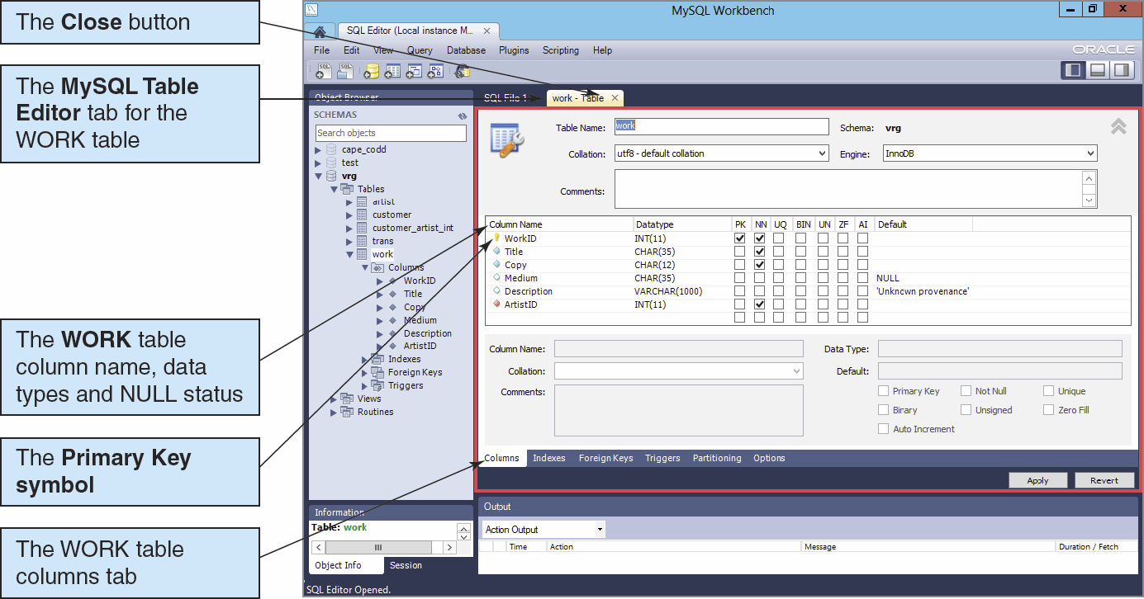
Viewing Tables: Column Properties

Slide 32
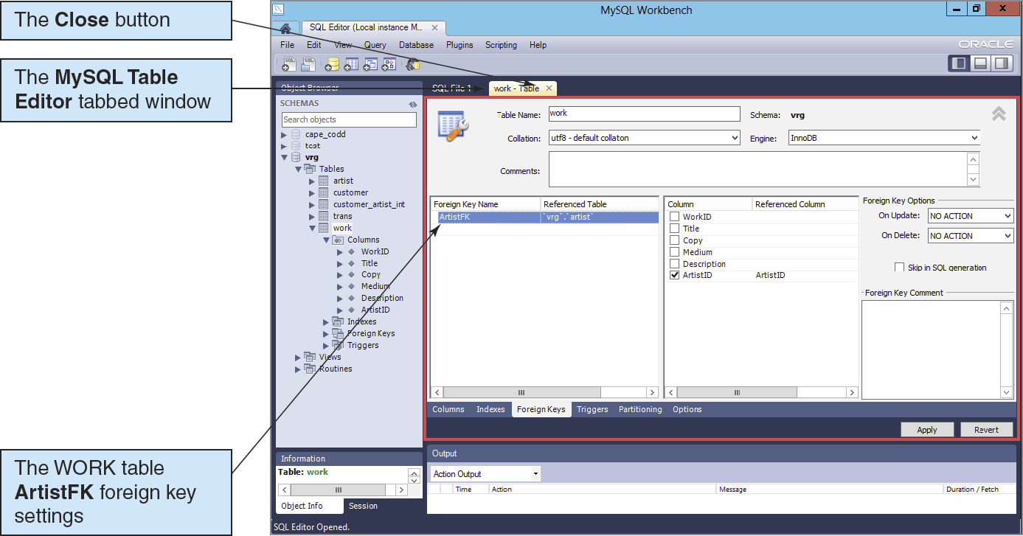
Viewing Tables: Foreign Key Properties

Slide 33
Indexes
Indexes are special data structures used to improve database performance.
MySQL Server automatically creates an index on all primary and foreign keys.
Additional indexes may be assigned on other columns that are:
Frequently used in WHERE clauses
Used for sorting data

Slide 34
Indexes
MySQL Server supports three kinds of indexes:
B-Tree
Hash
R-Tree

Slide 35
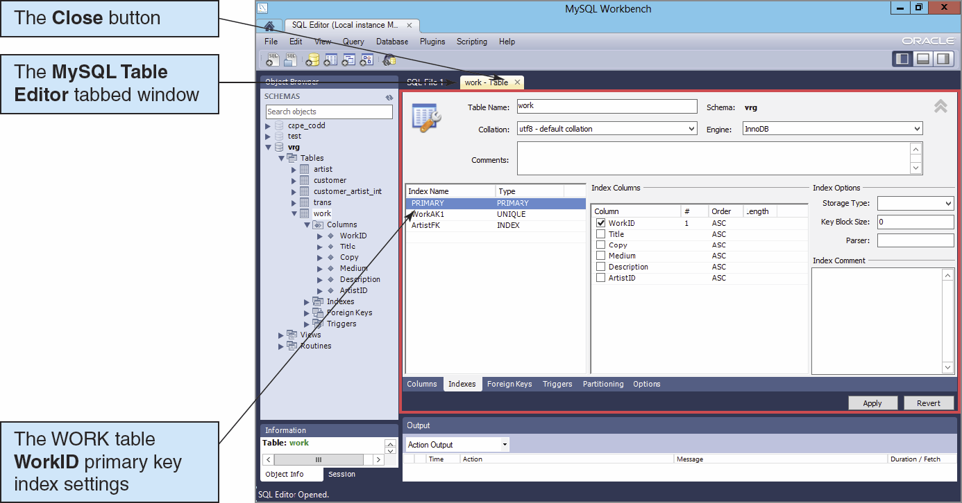
Viewing Tables: Index Properties

Slide 36
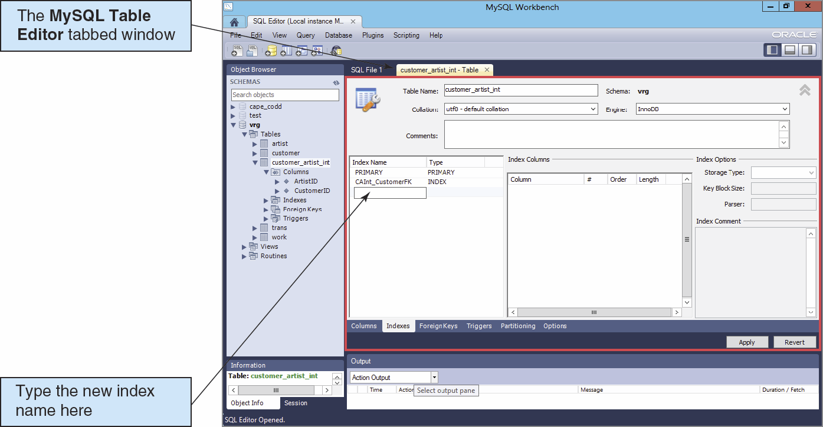
Creating an Index I

Slide 37
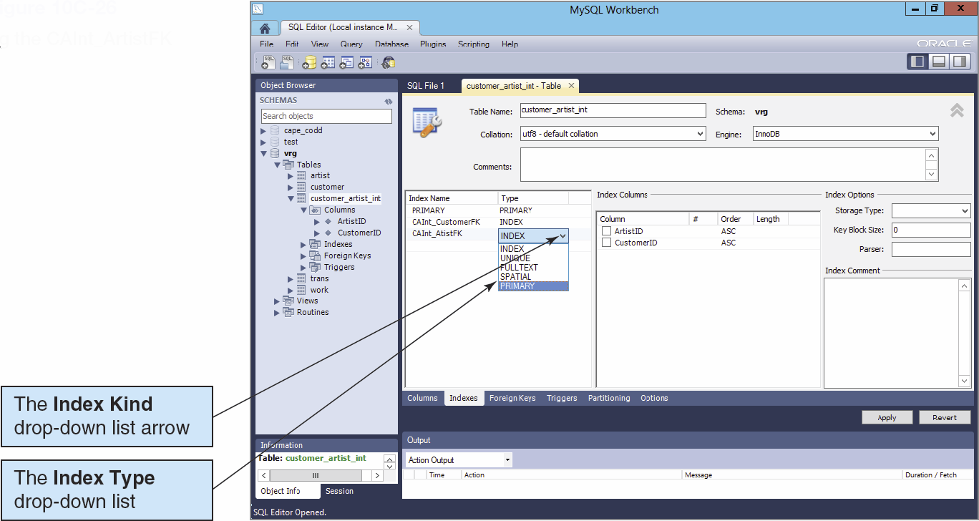
Creating an Index II

Slide 38
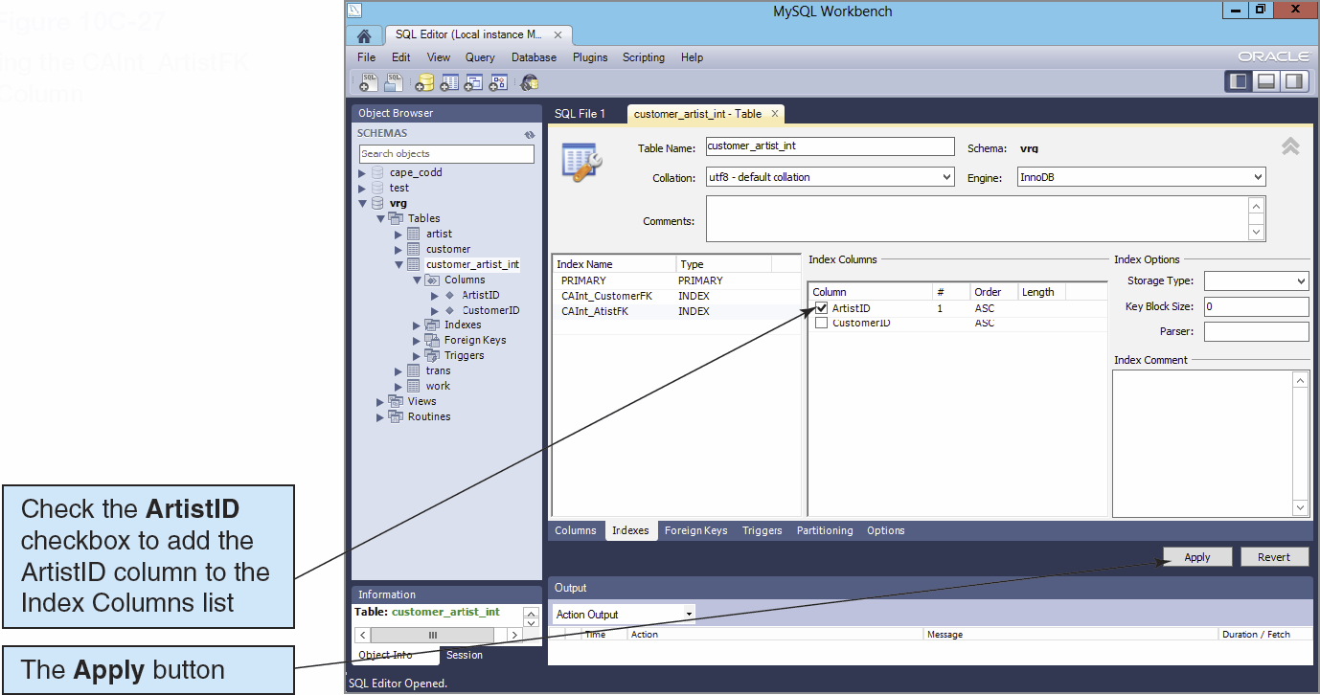
Creating an Index III

Slide 39
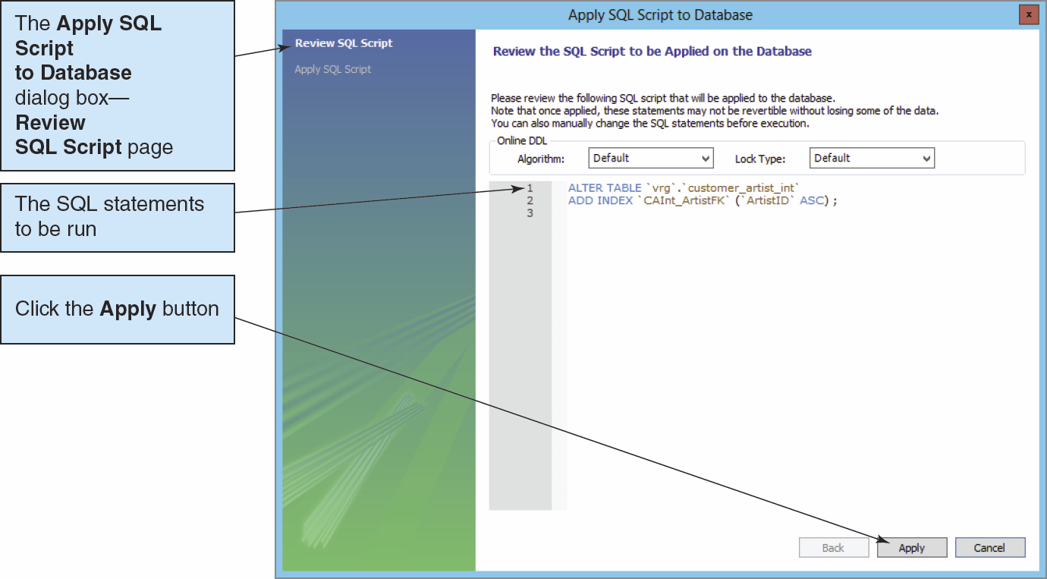
Creating an Index IV

Slide 40
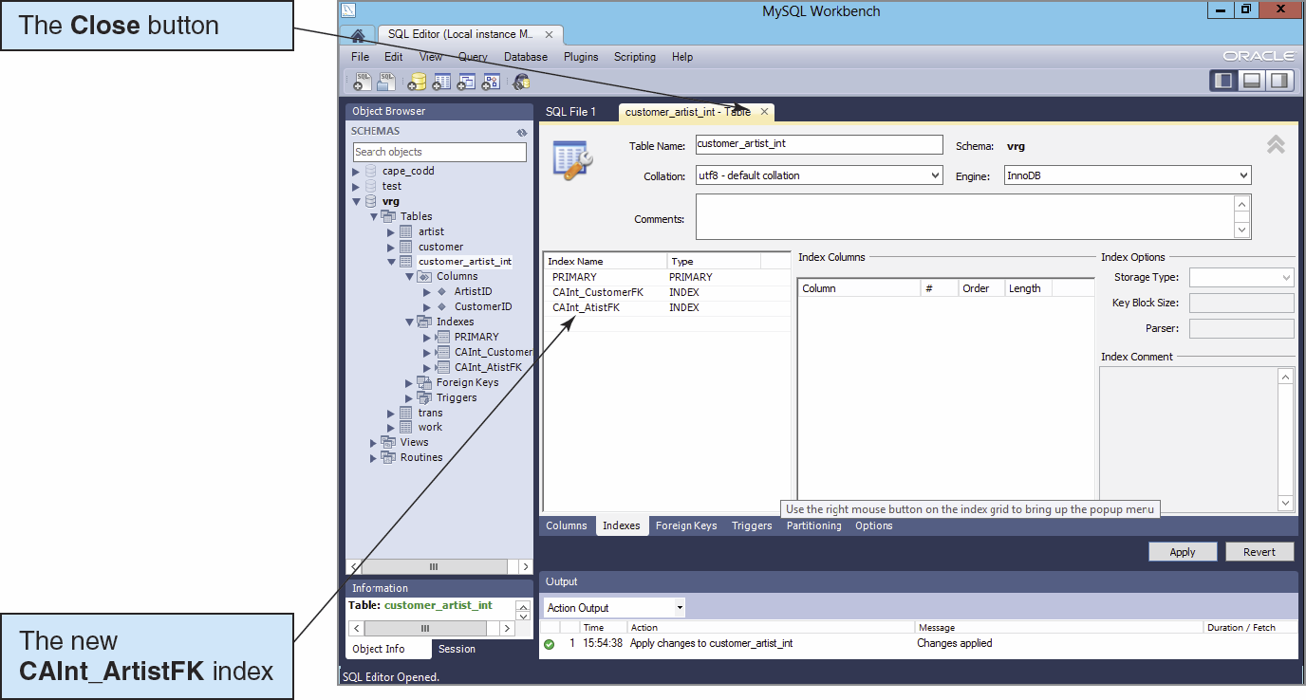
Creating an Index V

Slide 41
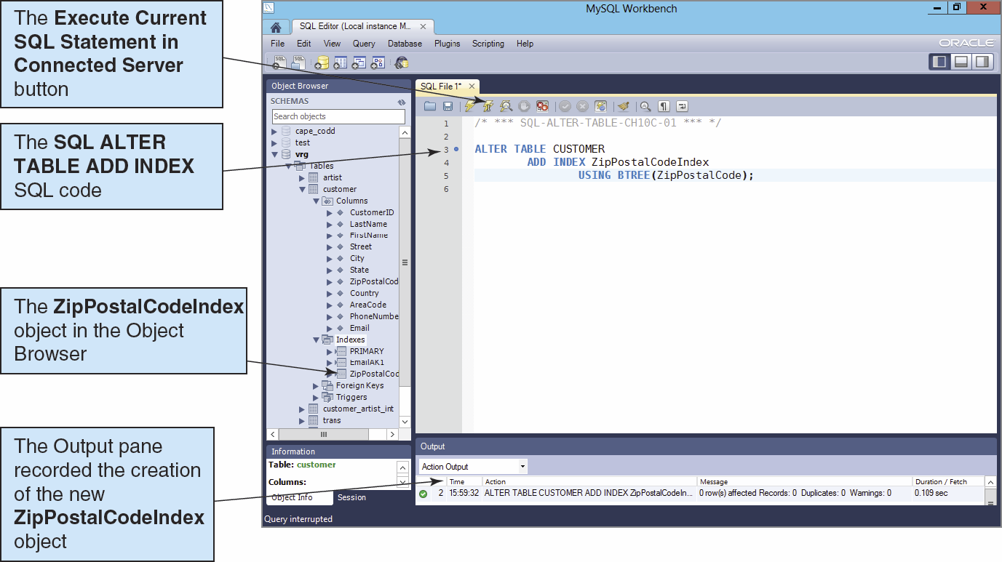
Creating an Index with SQL I

Slide 42
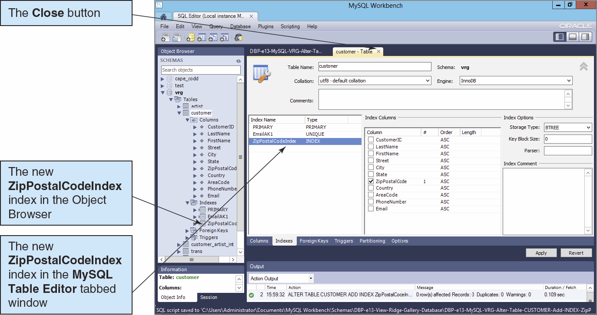
Creating an Index with SQL II

Slide 43
Populating the Tables: The AUTO_INCREMENT Keyword
The AUTO_INCREMENT keyword implements a new constraint for surrogate keys.
The increment value is always one.
The starting value is initially one, but can be modified using an ALTER TABLE statement:
ALTER TABLE TRANS AUTO_INCREMENT = 100;

Slide 44
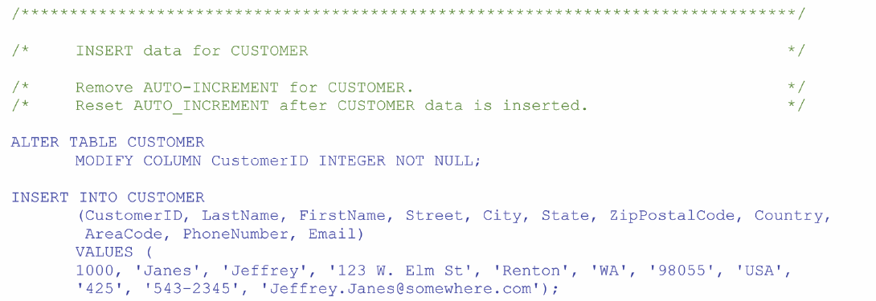
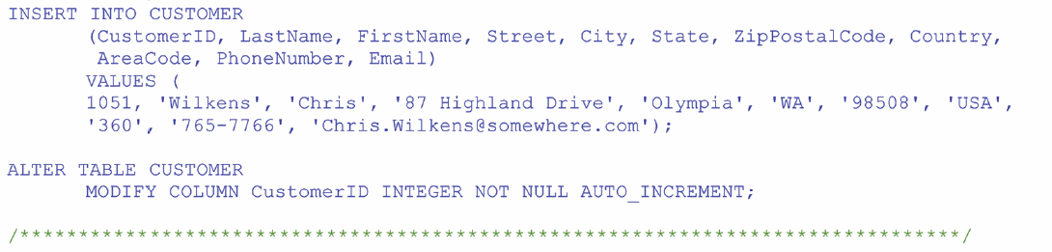
Populating the Tables: Working Around AUTO_INCREMENT

Slide 45
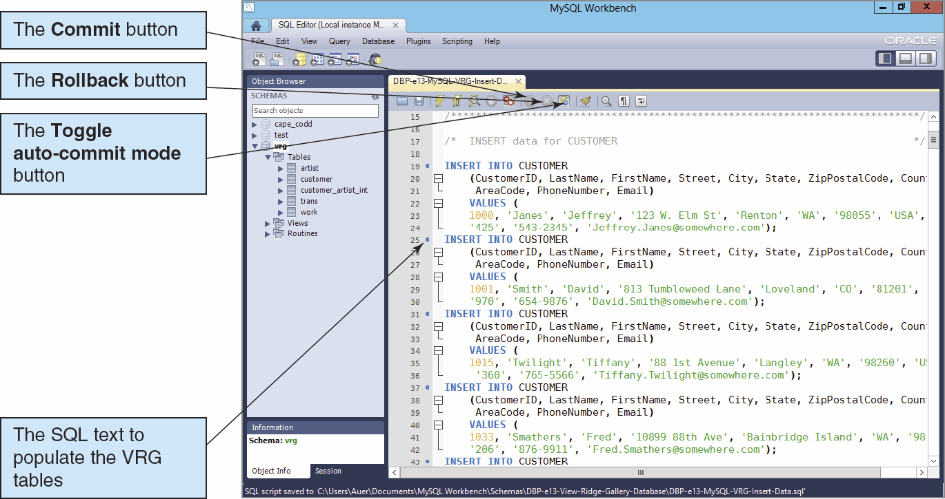
Transaction COMMIT in MySQL

Slide 46
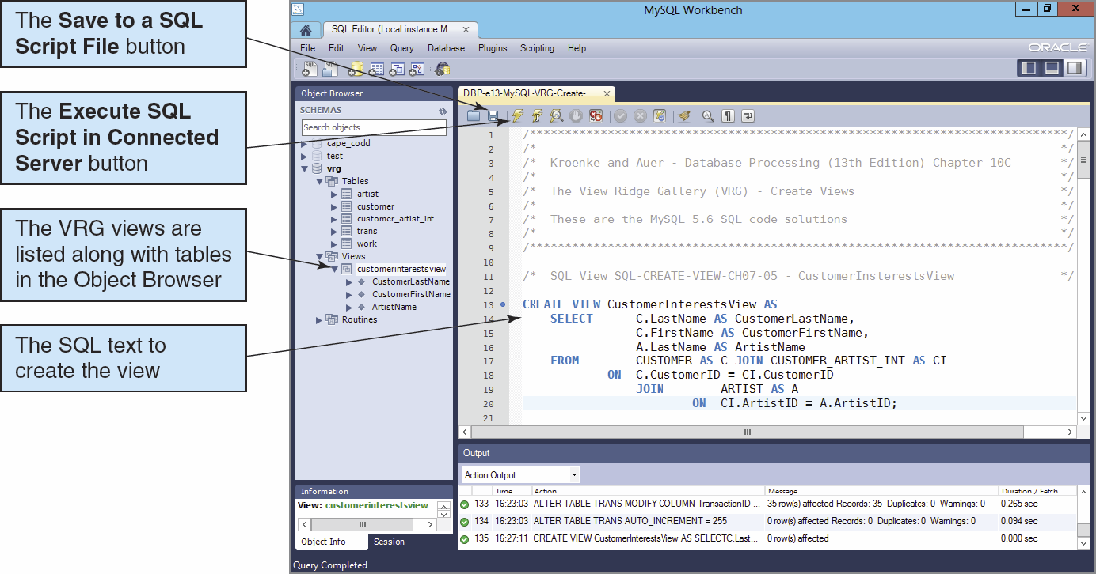
Creating a View I

Slide 47
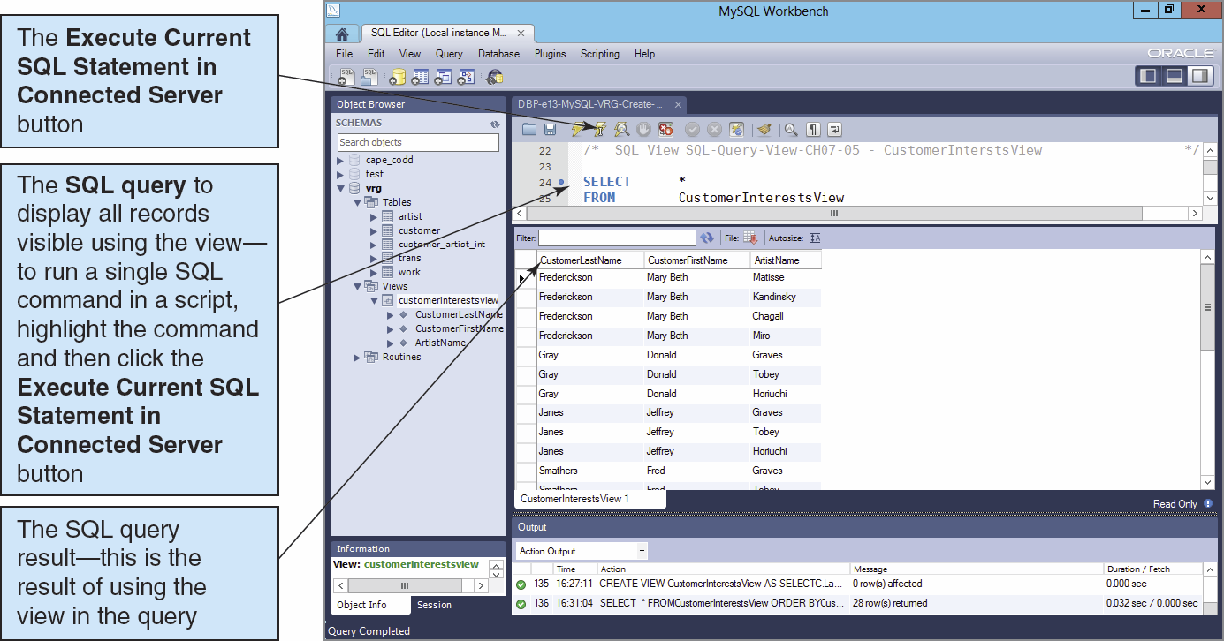
Creating a View II

Slide 48
Application Logic I
MySQL Server implements the SQL/Persistent Stored Modules (SQL/PSM) standard, but does have a special name for the MySQL variant of SQL—it is just called SQL!

Slide 49
Application Logic II
MySQL Server database application can be processed using:
Programming languages to invoke SQL Server DBMS commands
The MySQL Command Line utility to invoke database commands stored in .sql files
The MySQL Query Browser to invoke database commands stored in .sql files
Stored procedures
Triggers

Slide 50
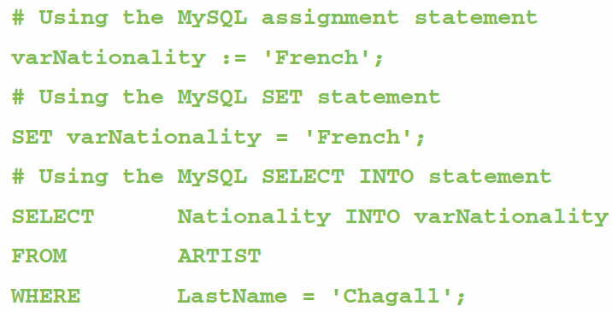
Application Logic: Parameters and Variables
A parameter is a value passed to a stored procedure.
A variable is a value used within the stored procedure.

Slide 51
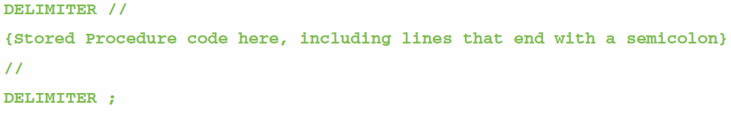
Application Logic: MySQL Statement Delimiters
MySQL must use a delimiter other than the SQL semicolon(;) when creating stored procedures and triggers:
This is a semicolon (;)

Slide 52
Application Logic: MySQL Block Structure
MySQL blocks must begin with BEGIN and end with END without semicolons.
BEGIN
DECLARE {optional}
{Executable statements {required}
END

Slide 53
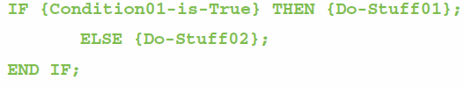
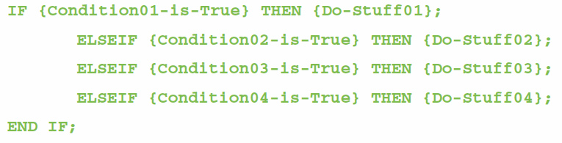
Application Logic: MySQL Control of Flow Statements I
IF…THEN…ELSE…END IF
IF…ELSEIF…END IF

Slide 54
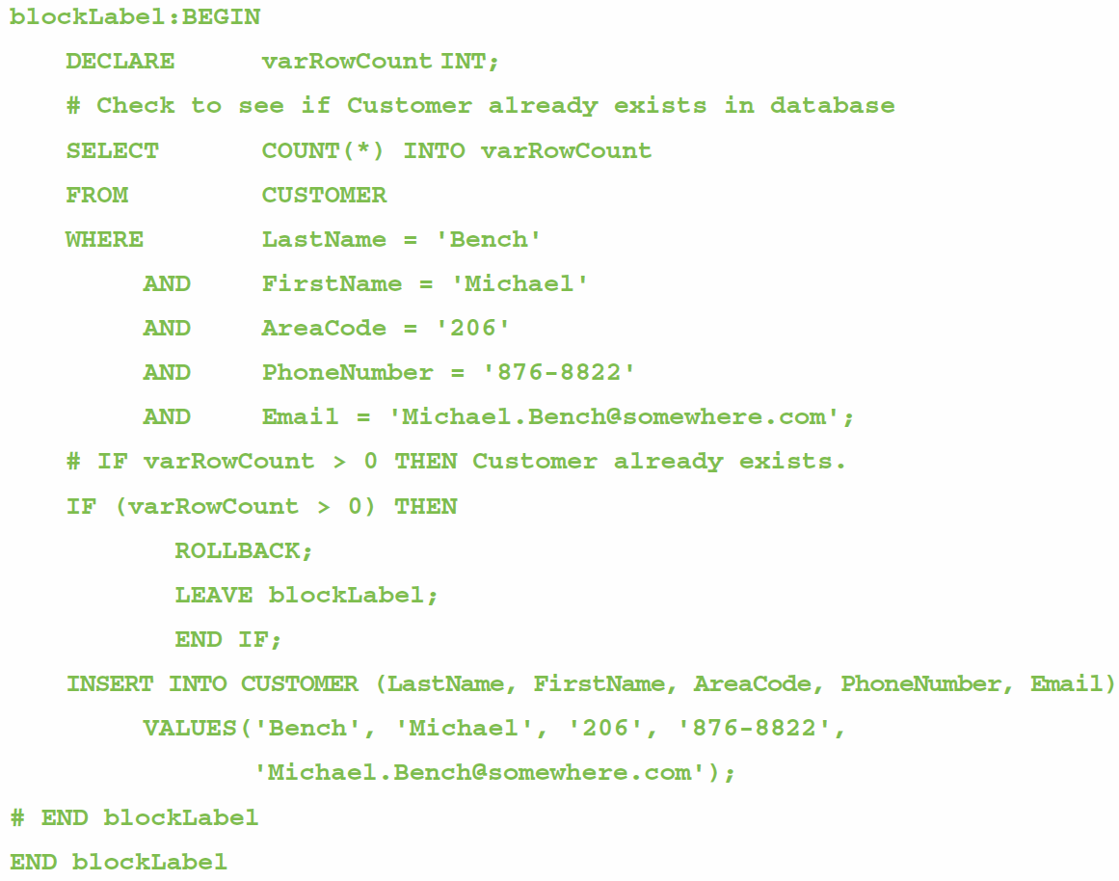
Application Logic: MySQL Control of Flow Statements II
BEGIN…END
Block Labels
ROLLBACK
LEAVE

Slide 55
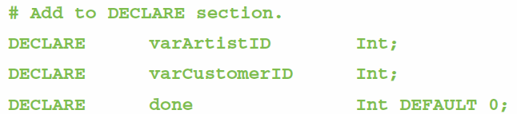
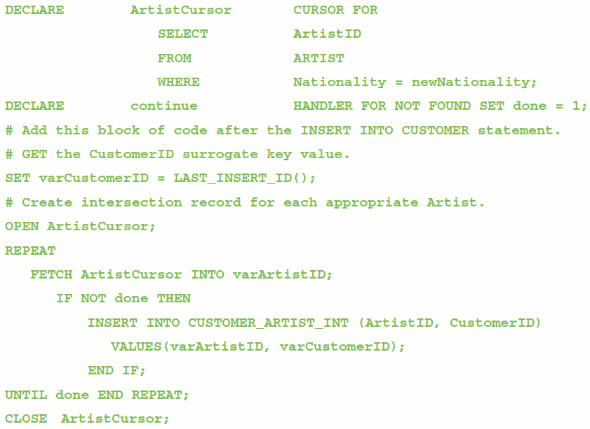
Application Logic: MySQL Cursor Statements
DECLARE
OPEN
FETCH
CLOSE

Slide 56
Application Logic: MySQL Output Statements
MySQL does not have output statements such as PRINT.
An SQL SELECT query can be used to provide limited output.

Slide 57
SQL/Persistent Stored Modules (SSL/PSM)
SQL/Persistent Stored Modules (SQL/PSM) is an ANSI/ISO standard for embedding procedural programming functionality into SQL.
Each DBMS product implements SQL/PSM in a different way, with some closer to the standard than others.
Microsoft SQL Server 2012 calls its version Transact-SQL (T-SQL).
Oracle Database 11g Release 2 calls its variant Procedural Language/SQL (PL/SQL).
MySQL 5.6 implements SQL/PSM, but has no special name for its variant of SQL.

Slide 58
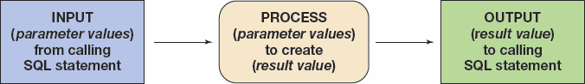
User-Defined Functions I
A user-defined function (stored function) is a stored set of SQL statements that:
is called by name from another SQL statement
may have input parameters passed to it by the calling SQL statement, and
returns an output value to the SQL statement that called the function.

Slide 59
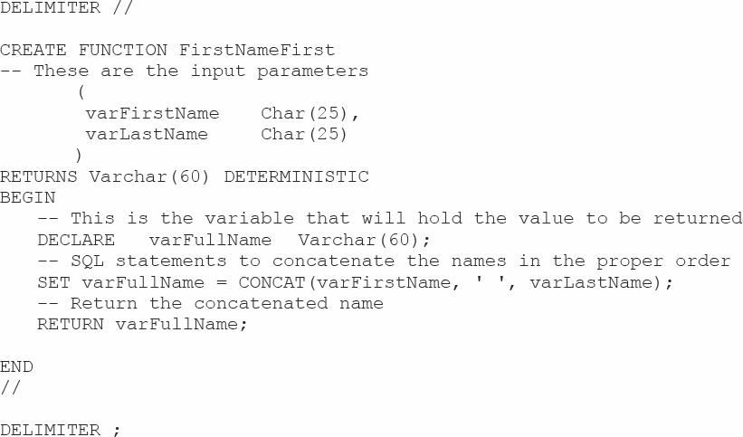
User-Defined Functions II The FirstNameFirst Function

Slide 60
User-Defined Functions III The FirstNameFirst Function
Using the FirstNameFirst function:
SELECT dbo.FristNameFirst(FirstName, LastName) AS CustomerName,
Sreet, City, State, ZipPostalCode
FROM CUSTOMER
ORDER BY CustomerName;

Slide 61
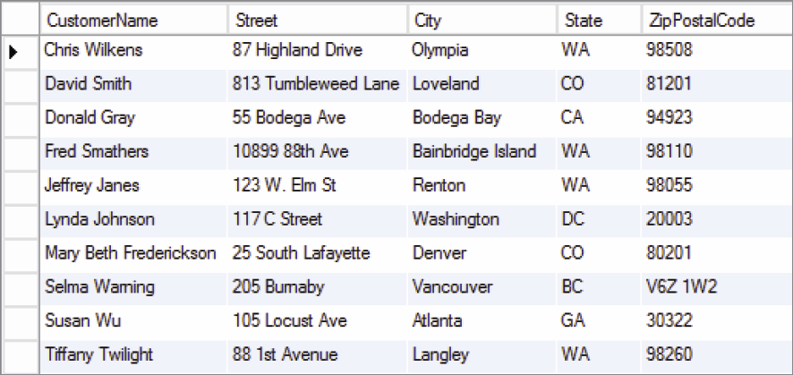
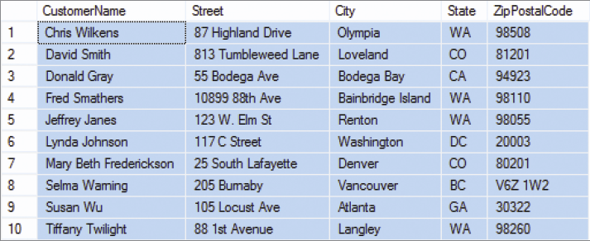
User-Defined Functions IV The FirstNameFirst Function
FirstNameFirst function results:

Slide 62
Stored Procedures
A stored procedure is a compiled program stored within the database.
Stored procedures are programs that can:
Have parameters.
Invoke other procedures and functions.
Return values.
Raise exceptions.
Creating stored procedures:
Write a stored procedure in a text file and process the commands using the MySQL Query Browser

Slide 63


Slide 64


Slide 65

Running Stored Procedures

Slide 66
Triggers
An SQL Server trigger is invoked when a specified database activity occurs.
Triggers can be used to:
Enforce business rules.
Set complex default values.
Update views.
Implement referential integrity actions.
MySQL Server only supports BEFORE and AFTER triggers.
Without the INSTEAD OF trigger, triggers on SQL views are not supported.
MySQL trigger support is very limited, and triggers may not be used to:
Make a change in the table that fired the trigger.
Return an output value—triggers can use the LEAVE keyword to exit without returning a value.
Make implicit or explicit ROLLBACKs of COMMITs.

Slide 67

Triggers Comparison

Slide 68

Adding the PRICELIST Table

Slide 69


Slide 70


Slide 71

Running Triggers

Slide 72

Safe Updates I

Slide 73

Safe Updates II

Slide 74

SHOW TRIGGERS

Slide 75

Table Editor Triggers Tab

Slide 76
Concurrency Control
One factor determines the concurrency control behavior of MySQL:
Transaction isolation level
Lock types include:
Record locks—a lock on the index record
Gap locks—generally, a lock on the unused index numbers between index records (see the MySQL documentation)
Next-Key locks—a combined record lock on the index record together with a gap lock on the unused index numbers before the index record itself

Slide 77

MySQL Concurrency Options

Slide 78

MySQL Security Model

Slide 79

MySQL Server Administration

Slide 80

MySQL Server Administration: Server Status

Slide 81

MySQL Logins and Privileges I

Slide 82

MySQL Logins and Privileges II

Slide 83

MySQL Logins and Privileges III

Slide 84

MySQL Logins and Privileges IV

Slide 85

MySQL Logins and Privileges V

Slide 86

MySQL Logins and Privileges VI

Slide 87

MySQL Logins and Privileges VII

Slide 88

MySQL Logins and Privileges VIII

Slide 89

MySQL Logins and Privileges IX

Slide 90

MySQL Backup

Slide 91

MySQL Restore

Slide 92
David Kroenke and David Auer Database Processing Fundamentals, Design, and Implementation (13th Edition)
End of Presentation:
Chapter Ten C

Slide 93

All rights reserved. No part of this publication may be reproduced, stored in a retrieval system, or transmitted, in any form or by any means, electronic, mechanical, photocopying, recording, or otherwise, without the prior written permission of the publisher. Printed in the United States of America.

